Slide 1
Environmental Economics
Presented by: Dr. Ruby Kazmi
Designation : Assistant Professor
Department of Economic
Shia P.G College Lucknow .

Slide 2
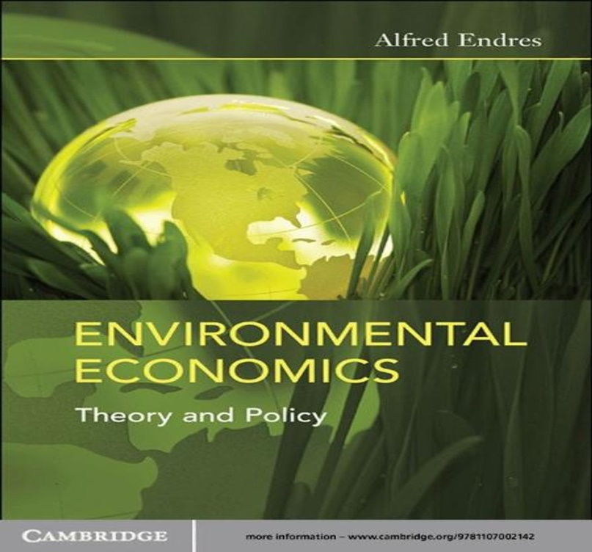
Unit 1: Environmental Economics

Slide 3
Introduction
Environmental economics is an area of economics that studies the financial impact of environmental policies. Environmental economics perform studies to determine the theoretical or empirical effects of environmental policies on the economy. This field of economics helps users design Appropriate environmental policies and analyze the effect and merits of existing or proposed policies .
Environmental economics is an area of economics that studies the financial impact of environmental policies …The field of economics helps users design appropriate environmental policies and analyze the effects and merits of existing or proposed policies.

Slide 4
Definition
Environmental Economics cab be defined as, ‘’That parts of economics which deals with the inter-relationship b/w environment and economic development and studies the ways and means by which neither is the former is impaired, nor is the latter impeded’
An environmentalist is , ``person who centre's his or her political philosophy on the need to preserve the natural environment and to halt or reserve the damage created by industrial development and pollution ‘’. Analogous with the term Green ,environmentalist is less narrowly political and denotes a wider range of views.

Slide 5
Scope of Environmental Economics
Pollution Control and Environment- Economic activities give rise to pollution .Pollution today has a very high cleanup and control cost with ultimately has to be borne by the consumers .
Conservation of Resources- The environment is the provider for all the materials needed by the man i.e., air ,water ,minerals, timber , shelters , food, etc.
Economic Growth and Environmental Balance-To achieve a higher economic growth ,resources have to be exploited and environment has to be harmed .Environment balance can only be obtained , if resources are not exploited and pollution is not formed.
Limits to Growth-Economic growth often creates the need for further economic growth for then following reasons :
1- Governments rely on economic growth to avoid problems of unemployment .
2- Governments are commonly judged by their ability to raise standards of living or to increase GNP.

Slide 6
Nature of Environmental Economics
Positive and Normative Aspect
Micro and Macro Aspect
Static and Dynamic Aspect
As a Social Science

Slide 7
Factors Affecting Environmental Economics
Human Resources
National Resources
Social and Cultural Institutions
Scientific and Technological Development
Market Conditions
Capital and Money Market

Slide 8
Environment Economy Interaction
Economic Activity has a material basis . It draws resources from the environment and provides Flows back into the Environment.
Linkage b/w environment and economy can be studied from the following point of consideration-
Environment in Economic Analysis
Economics in Environmental Analysis
Environmental Problems and their Solution in Economics
Mutual Dependence
Environment Provide Resource’s to the Economy
Environment Assimilates the waste and Provides Utility

Slide 9
Environment and Economy interaction

Slide 10
Environment and Economy Interaction
The natural environmental resources input function is central to understanding the relationship between economic growth and environment . Water , soil , air , biological , forest and fisheries resources are productive assets , whose quality helps determine the productivity of the economy .
Environmental economics is a sub- field of economics that is concerned with environmental issues. Particular issues include the costs and benefits of alternative environmental policies to deal with air pollution , water quality , toxic substances , solid waste and global warming .

Slide 11
Environmental { Natural Resources }
Raw Material {R}
Production Sector {R=F+W1
Waste {W1}
Final Product {F}
Household Sector{F=C=W2}
Consumed Product {C}
Waste {W2}
Material Balance Model

Slide 12
Material Balance Principle
The Environment has got a fixed Amount of mass which takes the form of soil, plants, minerals, etc. this mass changes from one form to another due to environmental or man-made influences. For example, water takes the form of ice, snow, vapour , etc. No matter what be the shape, the entire mass of water in the environment does not change. Even if the water is split into oxygen and hydrogen, the total quantum of the elements is same as that of the original water. The ‘’Material Balance Model’’ studies the relationship b/w the environment and the economy. In this model, we assume that the economy is made up of the production sector and household (consumption) sector.
It is in the production sector where all the economic activities of production come together with the factors of production being used to produce a finite quantum of goods. The household Sector on the other hand consumes the goods produced in the production sector. This Sector is made up of the consumers in the economy.

Slide 13
Entropy Law
The Entropy Law states that with every energy - based transformation a system looses part of its ability to perform useful mechanical work. In fact the economy is not an isolated system, it takes energy materials from outside, and produces waste and dissipated heat.
Entropy is a measure of disorder in a thermo dynamic system.
For example, heat moves by itself from a hotter to colder body.
Energy in a piece of coal is low entropy, more order, available for use.

Slide 14
References
Eugine , T: Environmental Economics
Karpagam , M: Environmental Economics
ML, Jhingon : Environmental Economics
From Wikipedia
https://www.slideshare.net/mobile/vivekpatidar7...

